Slide 1


Bi-weekly Master’s Thesis
Update Meeting
Meeting #1 : 16/02/21
Overview of the Thesis Topic
Weekly Progress Review
Next Steps

Slide 2

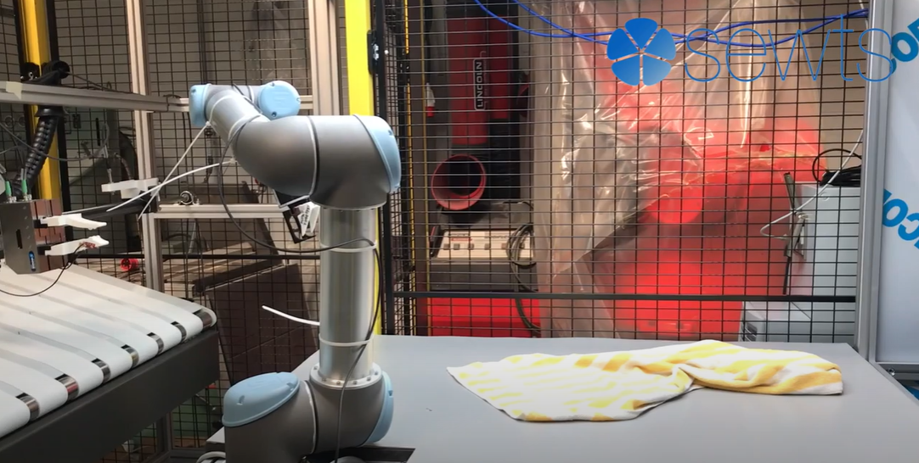
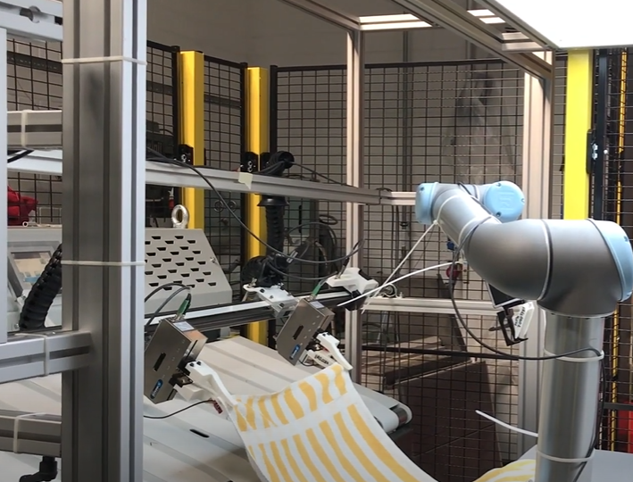
Thesis Proposal Overview
Problem
Primary task
Flattening a towel to feed to folding machine
Pipeline
Pre-manipulation – To obtain a flat seam
Pick the towel
Place on top of a mechanical assembly
Grasp point detection using computer vision pipeline
Feed to cartesian robot
Full flattening using cartesian robots
Feed to folding machine

Slide 3
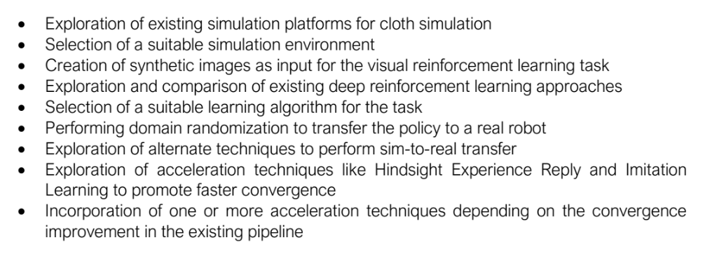
Thesis Proposal Overview
Proposal
Pre-manipulation for grasping
Using Model-free Visual Reinforcement Learning for fabric manipulation to expose a flat seam for grasping operation
Methodology

Slide 4
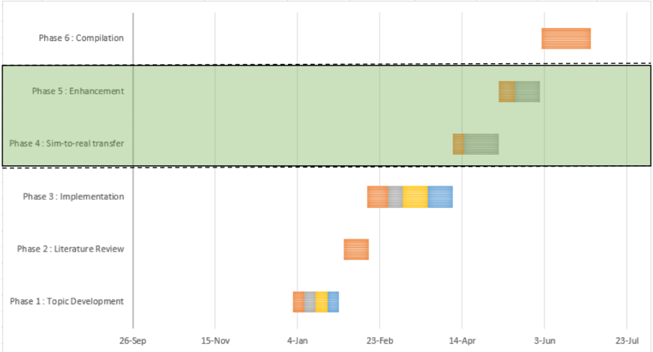
Thesis Proposal Overview
Plan

Slide 5
Weekly Review
09/02/21
Tasks
Talk to Marvin, Pol about Simulation✅
Check feasibility of model free approach versus model based✅
Run the official repository❌
Additional
Forked the repo and added detailed Installation instructions in Readme ✅
Doubts / Queries
To-Do Items for Next Week
Understand the existing repository completely
Code Soft Actor Critic from scratch
Literature Review from other papers
To-Do Later
Update overall plan
Testing various simulation platforms & selecting one
To-Do Later
Update overall plan
Testing various simulation platforms & selecting one
TO-DO LATER
Update overall plan
Testing various simulation platforms & selecting one

Slide 6
Weekly Review
16/02/21
Tasks
Literature Review from other papers✅
Run the official repository ⚠️ Computational issue
Understand the existing repository completely⚠️ In progress
Code Soft Actor Critic from scratch⚠️In progress
Doubts / Queries
To-Do Items for Next Week
Code Soft Actor Critic from scratch
Understand the existing repository completely
Explore usage of intermediate testing on simulation before sim-to-real transfer
Define use-case (for different type of towels (colour, texture, etc. ) / one type )
Check the no. of episodes needed
Check computational requirements

